Slide 1

DEPARTMENT OF COMPUTER SCIENCE AND ENGINEERING INTERNSHIP PROJECT ON “SITE LOGISTICS MANAGEMENT SYSTEM”
GOVERNMENT OF KARNATAKA DEPARTMENT OF TECHNICAL EDUCATION GOVERNMENT ENGINEERING COLLEGE Talakal,Koppal-583238
Presented By:
KRUTIKA [2LG21CS017] NAGARAJ [2LG21CS022] PRATIBHA [2LG21CS030]
KRISHNA V [2LG22CS404]

Slide 2
CONTENT
Abstract
Introduction
Existing & Proposed System
Project Scope
Methodology
Requirement Specifications
Results
Future Scope
Conclusion

Slide 3
ABSTRACT
The system facilitates effective management of key modules such as customer data, quotations, task lists, and payment tracking.
This project addresses the challenges of manual logistics management, such as data inconsistency, delays in communication, and lack of transparency.
The result is a comprehensive, centralized solution that increases productivity, reduces errors, and facilitates better decision-making in site logistics operations.

Slide 4
INTRODUCTION
Managing logistics on construction sites involves handling various tasks such as tracking materials, managing labor, generating quotations, and processing payments.
Traditional methods often lead to inefficiencies, communication gaps, and data management issues.
This system automates and streamlines logistics operations, offering real-time updates, secure data handling, and user-friendly interfaces.

Slide 5
EXISTING & PROPOSED SYSTEM
The existing system for managing site logistics in construction or industrial projects is predominantly manual and inefficient.
The Site Logistics Management System is a comprehensive, centralized, and digital solution designed to overcome the limitations of the existing manual system.
The proposed system will include modules for inventory management, material tracking, delivery scheduling, equipment allocation, and labour monitoring.

Slide 6
PROJECT SCOPE
Improve coordination between suppliers, workers, and site managers.
Use simple technology tools (like tracking software and mobile apps) for monitoring.
Optimize space usage and delivery timings on-site.
Support small to medium construction projects.

Slide 7
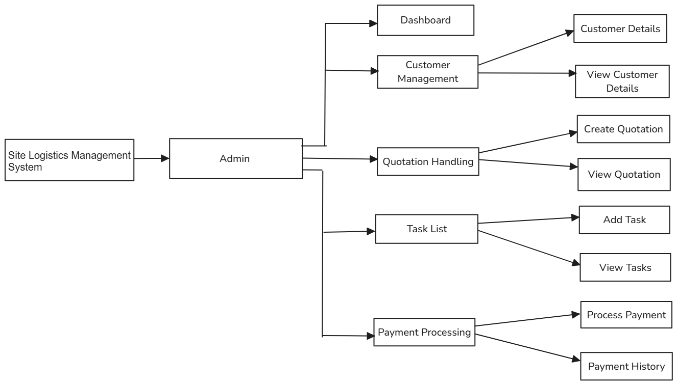
METHODOLOGY
Fig: Methodology

Slide 8
SOFTWARE REQUIREMENTS
Operating System: Windows
Programming Language: Java
Web Framework: Spring Boot framework
Database: MYSQL

Slide 9
HARDWARE REQUIREMENTS
Processor: Intel Core i5
Memory (RAM): 4GB (minimum) 8GB (maximum)
Hard Disk: 100GB (minimum)

Slide 10
ADVANTAGES
Centralized Management of all site logistics activities in one platform.
Improved Efficiency through automation of tasks and real-time tracking.
Better Communication between site managers, staff, and clients.
Time and Cost Saving by optimizing resource usage and scheduling.

Slide 11
DISADVANTAGES
High Initial Setup Cost
Technical Complexity
Dependence on Internet and Technology
Maintenance and Updates

Slide 12
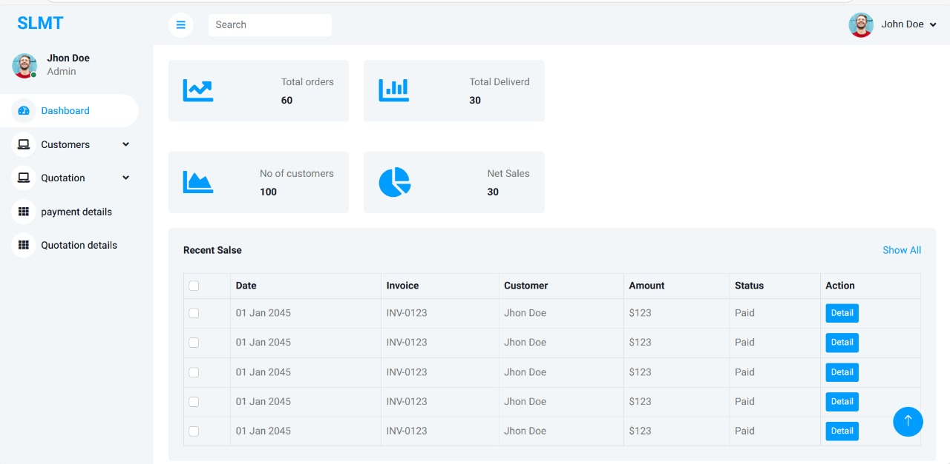
RESULTS
Fig1: Dashboard Page

Slide 13
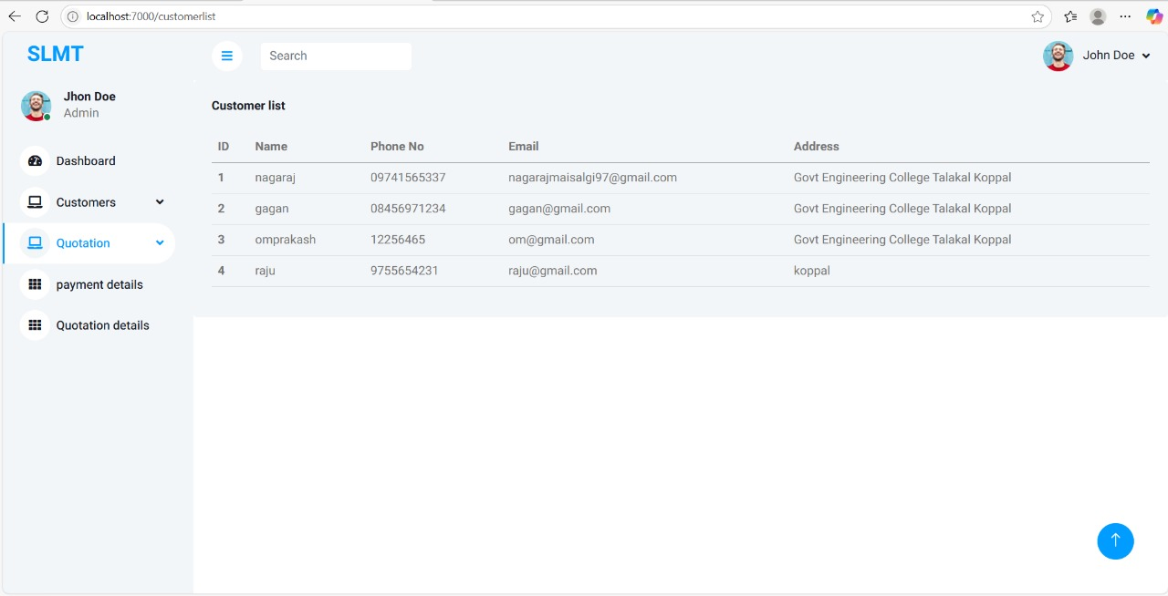
Fig2:Customer list

Slide 14
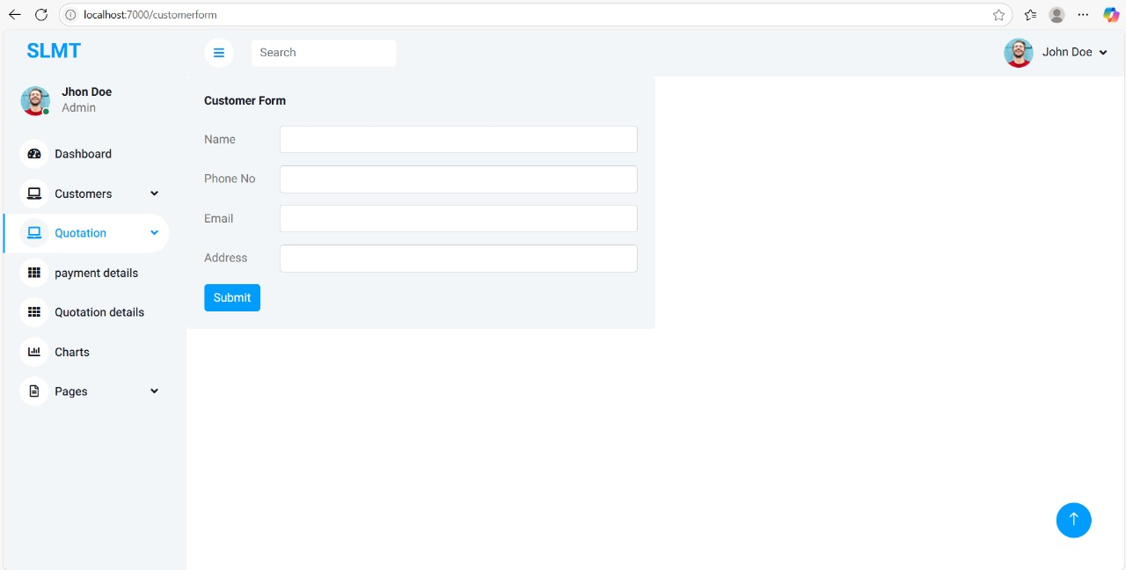
Fig3:Customer form

Slide 15
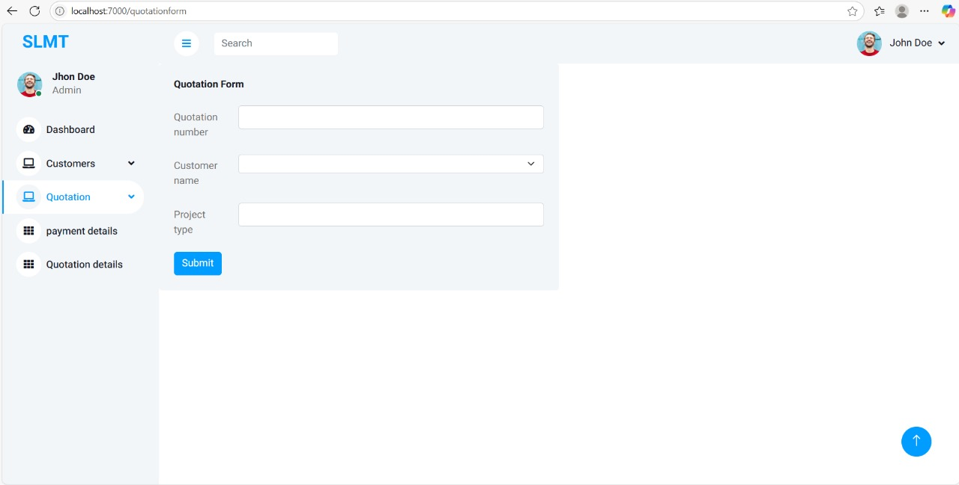
Fig4:Quotation form

Slide 16
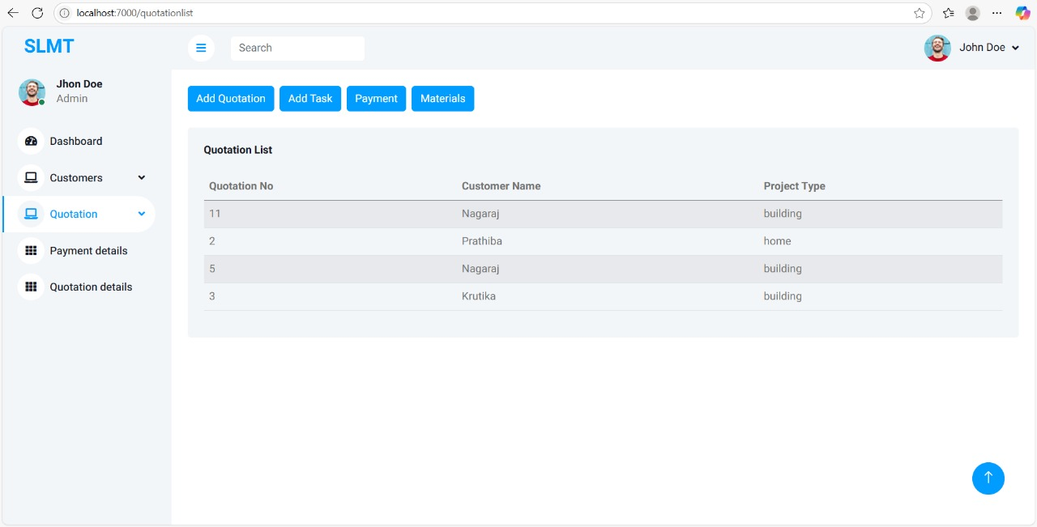
Fig5:Quotation list

Slide 17
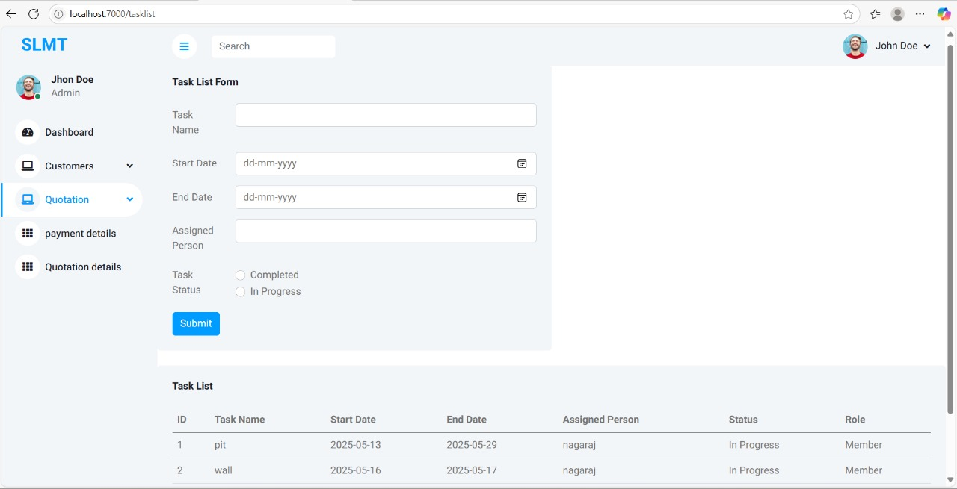
Fig6: Task list

Slide 18
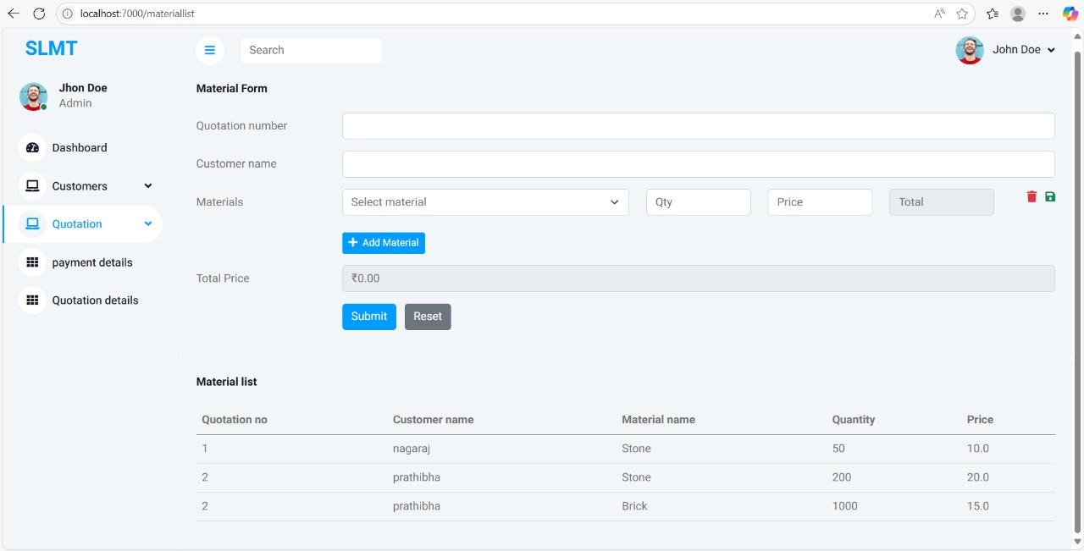
Fig7:Material form

Slide 19
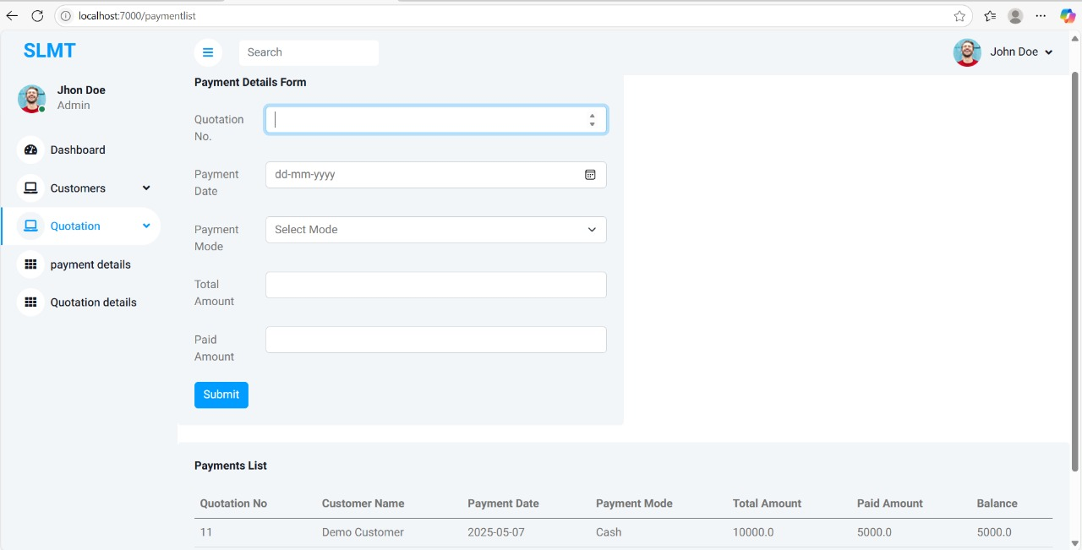
Fig8:Payment Form

Slide 20
FUTURE SCOPE
Mobile Application Integration
AI-based Task Scheduling
GPS & IoT Integration
Advanced Analytics & Reporting
Cloud Deployment

Slide 21
CONCLUSION
Logistics is key to a successful construction project.
Good planning improves efficiency and saves costs.
Technology will make logistics even better in the future.
Smarter logistics means safer and faster projects.

Slide 22
THANK YOU

